Slide 1



Session 3 Timers
By : Ahmad Hazem

Slide 2


What is the purpose for timers ?

Slide 3
Timers
Generating Time Delays
Generating waveforms
Counters to certain events
PWM generation
Input capturing events (Input capture mode)

Slide 4
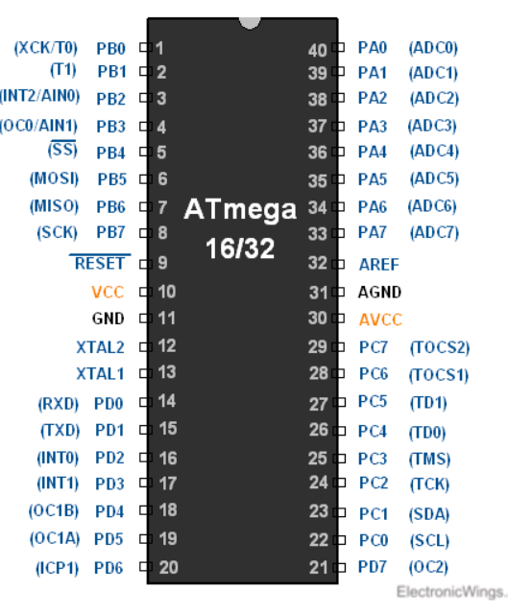
Timers on the ATMEGA32
In AVR ATmega16 / ATmega32, there are three timers:
Timer0: 8-bit timer (OC0)
Timer1: 16-bit timer (OC1A – OC1B)
Timer2: 8-bit timer (OC2)

Slide 5
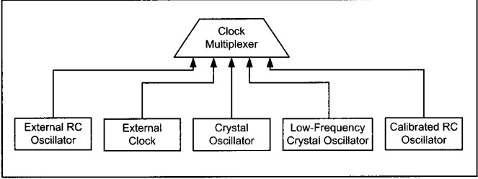
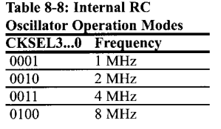
Clock sources (External or Internal)
To use the value of the external clock set the bits of CKSEL3 to CKSEL0 0000

Slide 6
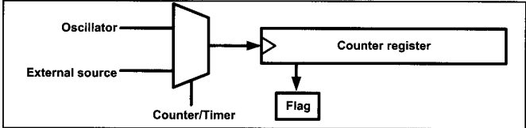
A clock pulse is passed from the internal rc circuit of the microcontroller or from any other external sources with each rising edge or falling edge the counter register increments by 1 when it overflows the flag is set.
This is the casual normal mode of any timer

Slide 7
Basic registers of the Timers
TCNTn: Timer / Counter Register :
Every timer has a timer/counter register. It is zero upon reset. We can access value or write a value to this register. It counts up with each clock pulse.
TCCRn: Timer Counter Control Register :
This register is used for setting the modes of timer/counter.
OCRn: Output Compare Register :
The value in this register is compared with the content of the TCNTn register. When they are equal, the OCFn flag will get set.

Slide 8
Basic flags of the Timers in TIFR
TOVn: Timer Overflow Flag :
Each timer has a Timer Overflow flag. When the timer overflows, this flag will get set. In order to clear it we write 1 to that bit.
OCFn flag : Output Compare Flag :
Each output compare has an interrupt flag that is set when the Timer counter register is equal to output compare register, . In order to clear it we write 1 to that bit.

Slide 9
Timers Modes
Normal Mode
Output Compare Mode
CTC Mode
PWM Mode
Fast PWM Mode

Slide 10

Timer 0 organization

Slide 11
Timer counter control register for Timer 0
Bit 7- FOC0: Force compare match
Write only a bit, which can be used while generating a wave. Writing 1 to this bit causes the wave generator to act as if a compare match has occurred.
Bit 6,3 – WGM00, WGM01 : Waveform generation mode
WGM00 | WGM01 | Timer 0 Mode
0 | 0 | Normal
0 | 1 | CTC (Clear Time on Compare Match)
1 | 0 | PWM (Pulse Width Modulation)
1 | 1 | Fast PWM

Slide 12
Timer counter control register for Timer 0
Bit 5,4 – COM01, COM02
These bits control the waveform generator. We will see this in the compare mode of the timer.
Bit 2,1,0 – CS02, CS01,CS00
These bits are used to select a clock source. When CS02: CS00 = 000, then timer is stopped. As it gets a value between 001 to 101, it gets a clock source and starts as the timer.
CS02 | CS01 | CS00 | Description
0 | 0 | 0 | Timer stops
0 | 0 | 1 | No pre-scaling
0 | 1 | 0 | Clk/8
0 | 1 | 1 | Clk/64
1 | 0 | 0 | Clk/256
1 | 0 | 1 | Clk/1024
1 | 1 | 0 | Clk from pin T0 (falling edge)
1 | 1 | 1 | Clk from pin T0 (rising edge)

Slide 13
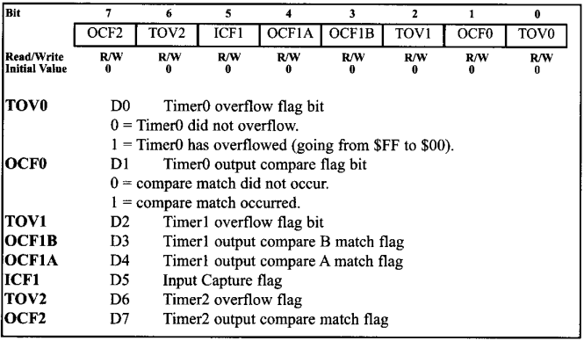
TIFR (Timer Interrupt flag register)

Slide 14
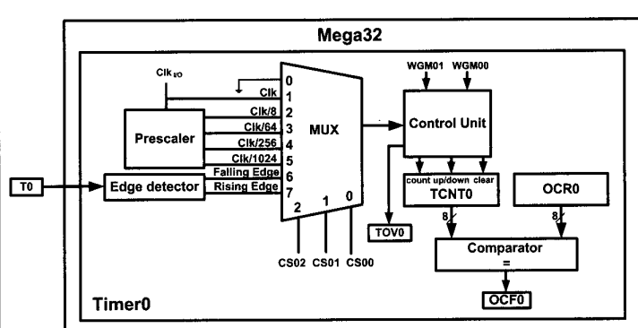

Slide 15


Timer 2 organization

Slide 16
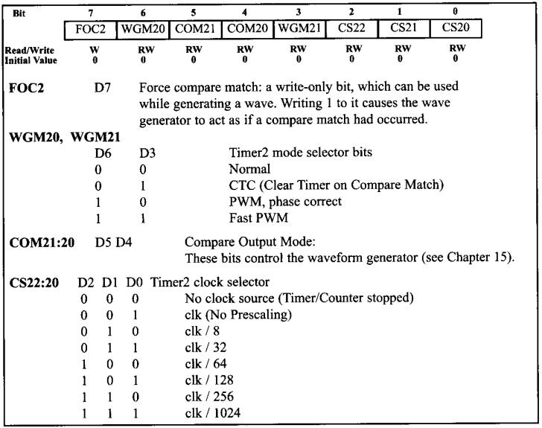
Timer 2 organization
Timer 2 can operate as a real time counter , when an oscillator is connected to pin TOCS1 and TOCS2 pins of the AVR, and set AS2 bit , otherwise internal clock is used
There are different pre-scale options from timer 0 see differences in this slide and slide 11.

Slide 17
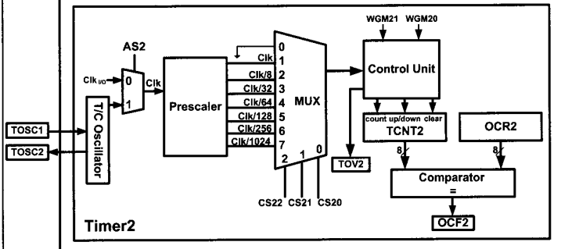

Slide 18

TIMSK: Timer / Counter Interrupt Mask Register
BIT 0, TOIE0 : Timer 0 overflow interrupt Enable
BIT 1, OCIE0 : Timer 0 output compare interrupt Enable
BIT 2, TOIE1 : Timer 1 overflow interrupt Enable
BIT 3, OCIE1B : Timer 1 output compare B interrupt Enable
BIT 4, OCIE1A: Timer 1 output compare A interrupt Enable
BIT 5, TICIE1 : Timer 1 input capture mode Enable
BIT 6, TOIE2 : Timer 2 overflow interrupt Enable
BIT 7, OCIE2 : Timer 2 output compare interrupt Enable 0

Slide 19
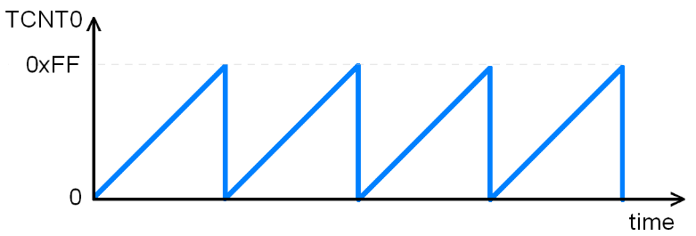
Normal Mode
The timer operates as a normal counter keeps incrementing until the Timer counter register overflows, and the Timer Overflow flag is set.

Slide 20
Solved Example
Calculate the delay generated by the timer, assuming that clock frequency is 8MHz and value of Timer counter register is 0x25. The value of Timer counter control register is 0x03.
TCCR = 0x03 = 0b00000011 since bit 0,1 are on a pre-scale of 64 is used 8M / 64 = 125000 Hz then frequency of each increment is 8 µs so time until the Timer counter register overflows is (0xFF – 0x25 + 0x01 = 219 tick )
Total delay = number of ticks × time of single tick = 14.106 ms

Slide 21
Example
Consider a microcontroller with an oscillator with frequency 1MHz , so if a delay of 100 microseconds is required , determine the value that the counter must reach before being cleared

Slide 22
Implement the previous example on ATMEL studio and generate the required 5 seconds delay using timer 0. Observe the delay on proteus simulator

Slide 23
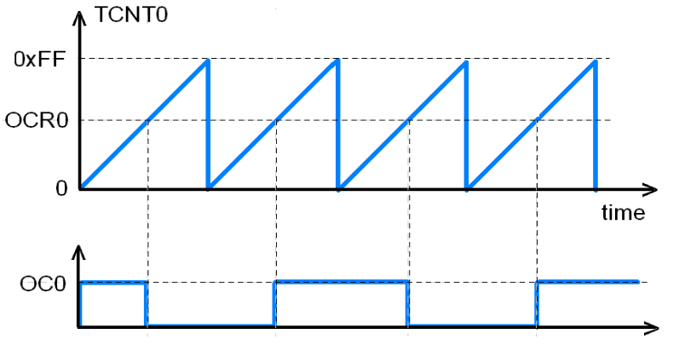
Square wave generation using normal mode (output compare mode)
Write a code to generate a square wave using normal mode of a timer

Slide 24
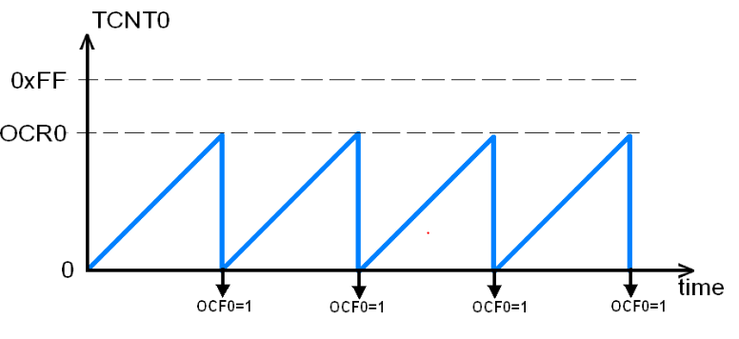
CTC (Clear Timer on Compare Match Mode)
The TCTn register increments and compared each time with register OCRn. If both registers are equal then, OCF is set, cleared or toggled.

Slide 25

CTC bits in TCCRn
Bit 5, 4- COM01:00 (compare output mode)
COM01:00 controls OC0 pin behavior, however, the DDR bit of corresponding OC0 pin must be set to make OC0 pin as an output.
COM01 | COM00 | Description
0 | 0 | The normal port operation, OC0 disconnected.
0 | 1 | Toggle OC0 on compare match
1 | 0 | Clear OC0 on compare match
1 | 1 | Set OC0 on compare match

Slide 26
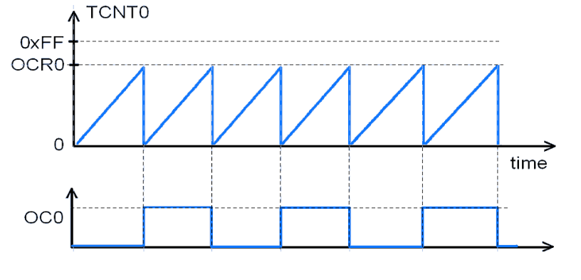
Square wave generation using CTC
Implement an AVR c code to generate a square wave using CTC mode and change the value of OCR0 to observe changes in wave duty cycle.

Slide 27
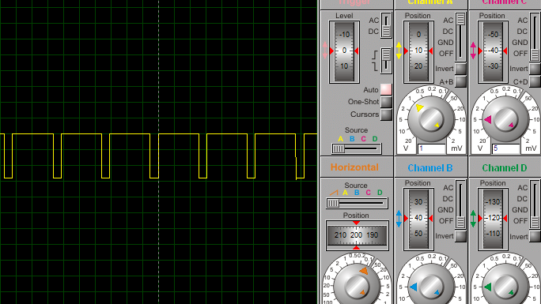
Homework (Generate the following wave using CTC mode)

